Slide 1
Enterprise Storage Analysis
Presented By: Jonathan Tan
James Wake
Julian Zhu

Slide 2
Table of Contents
Architecture
Back End
Base Indexer
Parallelization
Resumability
Using the Indexer
Front End Server
Web Application

Slide 3
Architecture
Enterprise Storage Analysis

Slide 4
Architecture
Traditional file system analysis software is monolithic
No separation of indexing and visualization components
Lacks the ability to save index
Prone to failure in the event one file causes a crash
Enterprise Storage Analysis System is the antithesis of monolithic
Complete separation of the indexer from the visualization complete
Indices are saved by default
Single file and even single index thread failures do not prevent completion of the full index
The indexer is resumable in the event of a crash

Slide 5
Architecture

Slide 6
Back End
Enterprise Storage Analysis
Jonathan Tan

Slide 7
Goals
Must satisfy three primary requirements
Must reliably index all files in a file system
Must execute in parallel
Must be resumable
Must work on Windows, Linux/UNIX, Solaris, macOS
Current indexer has been tested on Windows and Linux
Written in Node.js
Unifies front end and back end
Allows indexer to be largely platform-agnostic
Has compatibility with other technologies used

Slide 8
Base Indexer
Enterprise Storage Analysis

Slide 9
Goals
Index all files and directories in file system
Record file name, file size, date modified, group, owner, hostname
Save this information in a MongoDB database

Slide 10
File System Traversal
Chose to use a breadth-first traversal
Tests with depth-first traversal in future work
Use of Node.js File System module
lstatSync() to read file information, recognize symbolic links
readdirSync() to get files in a directory
Use of synchronous methods to limit I/O calls to one at a time
Store file information in FileSystemObject (FSO)
FSOs store file information, name of parent, and list of children files
Create a list of subdirectories in current root directory
Send file FSOs to database once they have been made
Recursively iterate until all directories are indexed

Slide 11
File Size Aggregation
Sizes of directories are not saved with other file information
Record directory FSOs in a hash instead of sending to database
Initially, sum the file sizes of children files
X:/MyFolder => { size: 42, fso: [Object] }
Use the FSO parent reference to update parent’s size in hash
Recursively bubble up to the root directory
Send all directories to database only once traversal is complete
Future work to test other implementations
Aggregate only at the very end
Aggregate in memory vs. aggregate in database

Slide 12
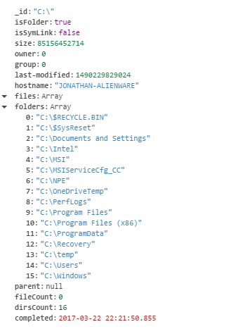
MongoDB
MongoDB was chosen as our database server
NoSQL database
Uses collections of documents
Documents are JSON-like objects, using key-value pairs
_id field in every document acts like a primary key in a relational database
Use the file name as _id value
Use the hostname and execution date of indexer as collection name
Wrote a Mongo class to interact with the database
Leverages the MongoDB Node.js API
Stores all database operations in a buffer and only sends operations after a threshold is met
Buffer size threshold of 2048 operations found to work well
Once indexing is complete, Mongo flushes all buffers and closes

Slide 13
Parallelization
ESA Back End

Slide 14
Goals
Divide up work such that tasks can be run concurrently
The indexer should complete within a reasonable time frame for very large file systems
Performance improvements versus a non-parallelized implementation

Slide 15
First Implementation
Uses the Node.js Child Process module
fork() the master process to create a pool of worker processes
Creates an inter-process communication (IPC) channel between master and worker
All workers connect to the database and handle sending operations individually
Master sends the worker a list of directories as an array
Worker indexes the directories and returns a JSON object
Contains FSOs of indexed files and directories, and next level of directories
This implementation was not good!
Each worker must connect separately to the database
Indexer would freeze for some reason

Slide 16
Second Implementation
Use spawn() instead of fork()
Use pipes to communicate instead of IPC channels
New issue: reading from a pipe doesn’t necessarily give you a complete or single message
Requires the creation of a simple protocol to which adhere to when communicating
To try to improve execution time, switched from round-robin to min-heap distribution
O(log n), but n is usually small (11 by default), so it’s close to O(1)
Also, now only the master handles database connection
Separation of concerns and only one database connection required

Slide 17
Performance Analysis
Commit: | 7ab8fad6ce6 | Trial 1 | Trial 2 | Trial 3 | Average
 |  | Time (s) | Time (s) | Time (s) | Time (s)
 | Root: | C:/Program Files (x86)
 | Items Indexed: | 127664
Buffer Threshold: | 512 | 33.161 | 33.059 | 33.034 | 33.084
 | 1024 | 33.794 | 33.311 | 33.851 | 33.652
 | 2048 | 32.312 | 31.615 | 32.232 | 32.053
 | 4096 | 31.860 | 31.898 | 32.308 | 32.022
 | Root: | D:/Program Files (x86)
 | Items Indexed: | 84438
Buffer Threshold: | 512 | 30.293 | 30.722 | 32.145 | 31.053
 | 1024 | 29.447 | 30.448 | 30.628 | 30.174
 | 2048 | 29.794 | 29.680 | 29.624 | 29.699
 | 4096 | 29.379 | 29.063 | 29.381 | 29.274
 | Root: | E:/Riot Games
 | Items Indexed: | 43856
Buffer Threshold: | 512 | 14.024 | 13.940 | 13.828 | 13.931
 | 1024 | 13.914 | 13.774 | 13.889 | 13.859
 | 2048 | 13.462 | 13.578 | 13.599 | 13.546
 | 4096 | 13.562 | 13.589 | 13.647 | 13.599
 | Root: | H:/
 | Items Indexed: | 18385
Buffer Threshold: | 512 | 4.175 | 4.134 | 4.106 | 4.138
 | 1024 | 4.166 | 4.187 | 4.163 | 4.172
 | 2048 | 4.007 | 4.072 | 4.045 | 4.041
 | 4096 | 4.120 | 4.107 | 4.072 | 4.100
Commit: | 0e5f7a35f01 | Trial 1 | Trial 2 | Trial 3 | Average
Worker Pool Size: | 11 | Time (s) | Time (s) | Time (s) | Time (s)
 | Root: | C:/Program Files (x86)
 | Items Indexed: | 127664
Buffer Threshold: | 512 | 13.996 | 13.940 | 13.958 | 13.964
 | 1024 | 13.883 | 13.889 | 13.857 | 13.876
 | 2048 | 13.622 | 13.778 | 13.863 | 13.754
 | 4096 | 13.821 | 13.666 | 13.682 | 13.723
 | Root: | D:/Program Files (x86)
 | Items Indexed: | 84438
Buffer Threshold: | 512 | 18.142 | 18.074 | 18.125 | 18.114
 | 1024 | 18.237 | 18.242 | 18.174 | 18.218
 | 2048 | 17.883 | 18.017 | 18.084 | 17.994
 | 4096 | 18.034 | 18.115 | 18.032 | 18.060
 | Root: | E:/Riot Games
 | Items Indexed: | 43856
Buffer Threshold: | 512 | 9.622 | 9.846 | 9.670 | 9.713
 | 1024 | 9.647 | 9.775 | 9.852 | 9.758
 | 2048 | 9.644 | 9.539 | 9.606 | 9.596
 | 4096 | 9.664 | 9.624 | 9.659 | 9.649
 | Root: | H:/
 | Items Indexed: | 18385
Buffer Threshold: | 512 | 5.225 | 5.208 | 5.225 | 5.219
 | 1024 | 5.216 | 5.202 | 5.219 | 5.212
 | 2048 | 5.220 | 5.210 | 5.209 | 5.213
 | 4096 | 5.304 | 5.261 | 5.243 | 5.270
Commit: | c49a3c9f0da | Trial 1 | Trial 2 | Trial 3 | Average
Max Worker Pool Size: | 11 | Time (s) | Time (s) | Time (s) | Time (s)
 | Root: | C:/Program Files (x86)
 | Items Indexed: | 127664
Buffer Threshold: | 512 | 10.430 | 11.079 | 10.724 | 10.744
 | 1024 | 10.852 | 10.483 | 11.404 | 10.913
 | 2048 | 10.903 | 10.591 | 11.800 | 11.098
 | 4096 | 10.506 | 10.849 | 10.738 | 10.698
 | Root: | D:/Program Files (x86)
 | Items Indexed: | 84438
Buffer Threshold: | 512 | 9.248 | 9.176 | 9.193 | 9.206
 | 1024 | 9.333 | 9.211 | 9.276 | 9.273
 | 2048 | 9.127 | 9.377 | 9.230 | 9.245
 | 4096 | 9.247 | 9.218 | 9.215 | 9.227
 | Root: | E:/Riot Games
 | Items Indexed: | 43856
Buffer Threshold: | 512 | 7.394 | 7.155 | 7.126 | 7.225
 | 1024 | 7.276 | 7.577 | 7.576 | 7.477
 | 2048 | 7.556 | 7.254 | 7.277 | 7.362
 | 4096 | 7.688 | 7.671 | 7.627 | 7.662
 | Root: | H:/
 | Items Indexed: | 18385
Buffer Threshold: | 512 | 6.559 | 6.592 | 6.713 | 6.622
 | 1024 | 6.432 | 6.512 | 6.474 | 6.473
 | 2048 | 6.545 | 6.458 | 6.540 | 6.514
 | 4096 | 6.619 | 6.582 | 6.493 | 6.565
Single-process Implementation
First Implementation (fork())
Second Implementation (spawn())

Slide 18
Performance Analysis

Slide 19
Final Implementation
For resumability and scalability reasons, switch pipes to a message queue
Chose to use RabbitMQ for the message queue
Messages between processes are now handled by the RabbitMQ server
Automatically handles distribution so we no longer need the min-heap
Also, we don’t need our own protocol implementation
All processes must connect to the message queue server
Unavoidable overhead
Two queues
Master queue to enqueue tasks for workers
Worker queue to receives replies from workers

Slide 20
Resumability
ESA Back End

Slide 21
Goals
Allow the user to pause indexing and resume at a later time
Handle crashes and allow the indexer to be resumed
Catch signals and allow the indexer to be resumed
Minimize impact on performance

Slide 22
RabbitMQ
Messaging queue service
Queues persist on server, so they can be retrieved at a later time
Leverages the amqplib module to use RabbitMQ
Master sends a message to worker by enqueueing it in the master queue
Worker tries to process the message
If successful, worker acks the message and replies in worker queue
If not, worker dies and the message is left unacked
If a worker dies, master will attempt to spawn a new worker
Master process will terminate if too many workers are spawned

Slide 23
RabbitMQ
Master/worker queues are named specific to the run
Take the timestamp of when the run began
Encipher it (future work can use a hash instead)
Concatenate a _M or _W to identify between two queues
Use enciphered name as a “resume key” for the user
If the run must terminate prematurely, provide the user the resume key
If the user provides the key in a future execution, we can resume with the saved queues
Delete the queues if the indexer terminates properly
To resume, we need a few other state variables (file size hash, command-line args, etc.)
Save these in RabbitMQ since it’s available
Create a new queue with a _S name and store all variables in there

Slide 24
Performance Analysis
Commit: | 7eb4e924599 | Trial 1 | Trial 2 | Trial 3 | Average
Max Worker Pool Size: | 11 | Time (s) | Time (s) | Time (s) | Time (s)
Root: | C:/Windows | 46.390 | 47.364 | 46.239 | 46.664
Items Indexed: | 163431
Size (GB): | 17.8
Root: | E:/ | 11.294 | 10.898 | 11.207 | 11.133
Items Indexed: | 79113
Size (GB): | 110.3
Pre-RabbitMQ
Parallel
Commit: | 5bb923b2f96 | Trial 1 | Trial 2 | Trial 3 | Average
Worker Pool Size: | 11 | Time (s) | Time (s) | Time (s) | Time (s)
Root: | C:/Windows | 47.775 | 47.370 | 48.500 | 47.882
Items Indexed: | 163431
Size (GB): | 17.8
Root: | E:/ | 12.934 | 12.959 | 13.081 | 12.991
Items Indexed: | 79113
Size (GB): | 110.3
Post-RabbitMQ
Parallel
Commit: | b152dac6ffd | Trial 1 | Trial 2 | Trial 3 | Average
Worker Pool Size: | 11 | Time (s) | Time (s) | Time (s) | Time (s)
Root: | C:/Windows | 48.013 | 48.027 | 47.660 | 47.900
Items Indexed: | 163431
Size (GB): | 17.8
Root: | E:/ | 14.071 | 14.150 | 13.787 | 14.003
Items Indexed: | 79113
Size (GB): | 110.3
Fully Resumable

Slide 25
Performance Analysis

Slide 26
Signal Handling
We also include the ability to catch SIGINTs
Create a stop flag which is set when the signal is caught
When the flag is set, do not send any more to workers
Instead, save returned message in a list
Once all workers return, we can close the worker pool
Then, insert all saved message in master queue
If we don’t close first, workers will attempt to read from the queue
Now, we can terminate and provide the user the resume key
Worker processes can also catch SIGINTs
If caught, worker will nack current message and exit
Redundant processing may occur, but MongoDB will check and remove duplicates

Slide 27
Using the Indexer
ESA Back End

Slide 28
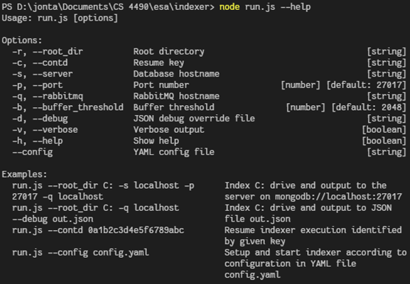
Command-Line Options

Slide 29
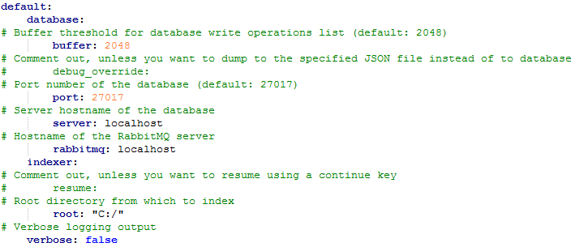
Configuration YAML file

Slide 30
Front End
James Wake

Slide 31
Components
NodeJS Server
ExpressJS (Web Server)
SocketIO API
SocketHandle
Treemap Request API
Web Application
Iterative Development
Treemap
Filters
File Browser

Slide 32
NodeJS Server
Enterprise Storage Analysis

Slide 33
NodeJS Server
Provides a cross platform server environment
Unifies our codebase to one language, JavaScript
Unified Build System
Extensive libraries exist to handle almost anything
Good modern web application support

Slide 34
SocketIO API
SocketIO provides a framework for working with WebSockets
Socket programming over HTTP
This allows for a stateful server for every socket connection
Provides native support for JSON data transfer between client and server
Supports simple bidirectional communications

Slide 35
SocketHandle
This class provides synchronized callback support to all new connections
As each socket connects, a new SocketHandle is created
The SocketHandle adds the initialized API callbacks to the socket
Static methods allow for the addition of new callbacks on the fly
This class allows for the API to be extended easily
Extensibility

Slide 36
Treemap Request API Example
Client Side Request and Response Handler

Slide 37
Treemap Request API Example
Server Side Request and Response Handler

Slide 38
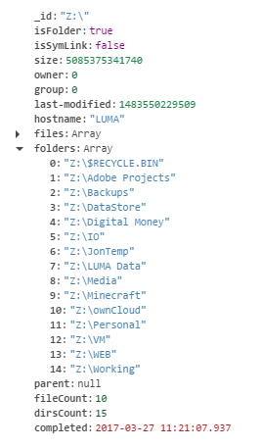
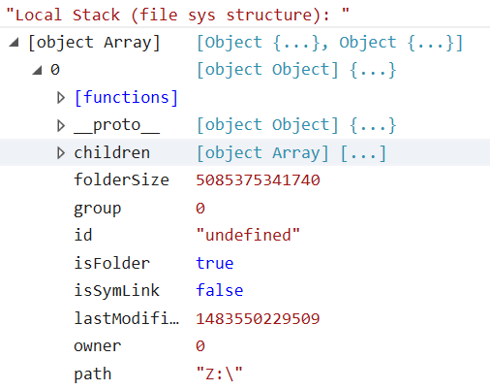
Treemap Request API Example
MongoDB Root Document
Server Response for Root Tree
As seen by browser

Slide 39
Web Application
Enterprise Storage Analysis

Slide 40
Why React?
Flexibility
Reusability

Slide 41
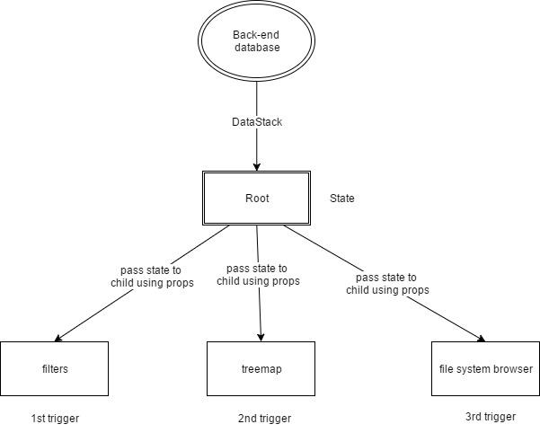
React Mechanism
Figure1:
One-way binding

Slide 42
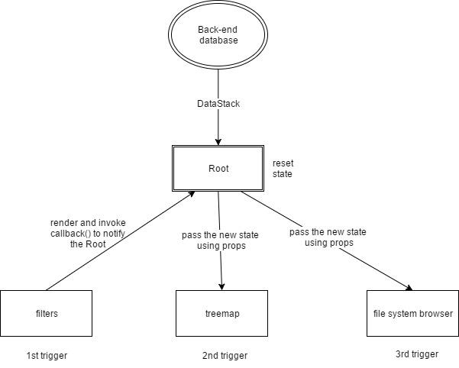
React Mechanism
Figure2: Two-way binding -- filter

Slide 43
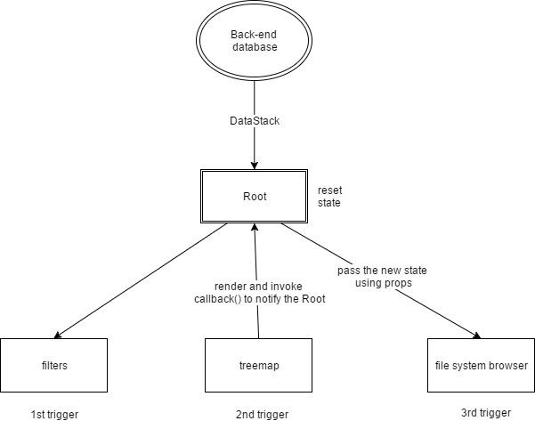
File Browser
Figure3: Two-way binding –- treemap

Slide 44
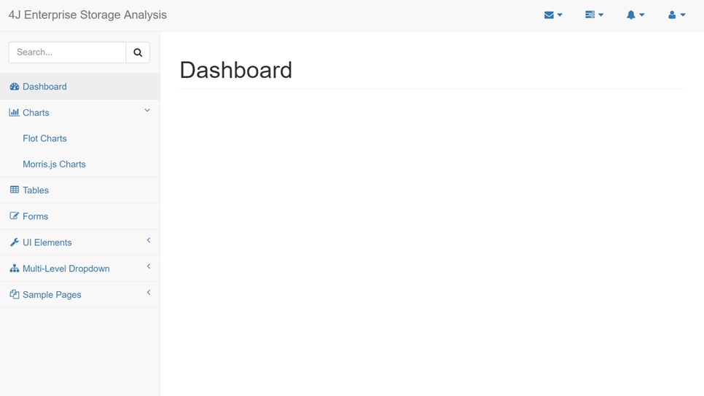
Front-end UI evolution
Pro: neat and clean, responsive
Con: this design cannot provide enough information on a single page; users have to keep switching pages

Slide 45
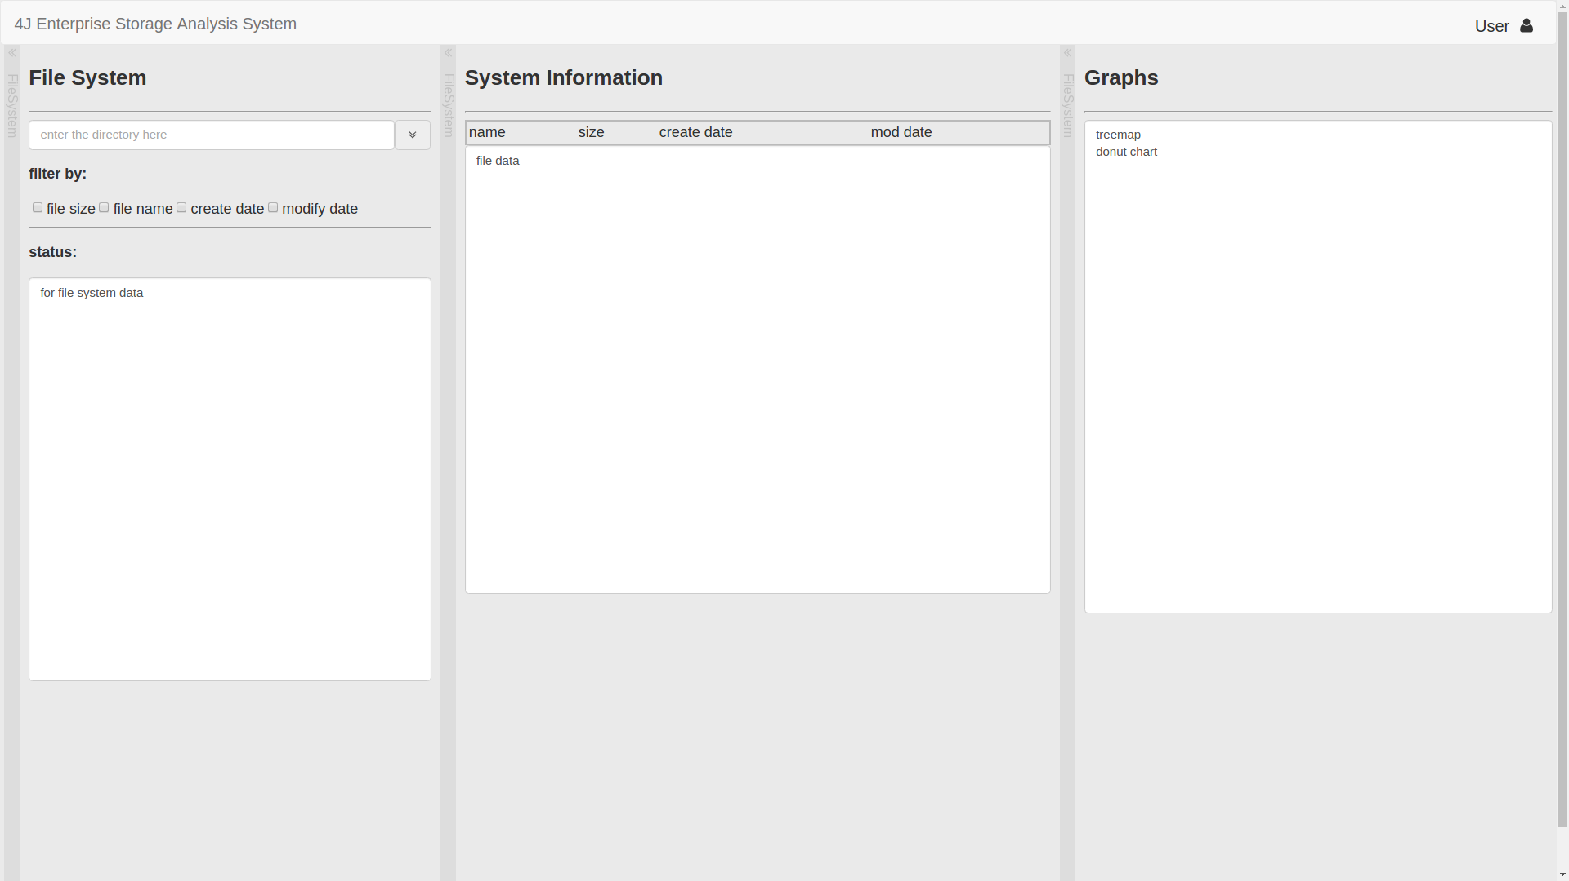
Front-end UI evolution
Version2: Three Slideable Panels
Pro: responsive, efficiency, and easy to use
Con: so far so good (before the final version comes out)

Slide 46
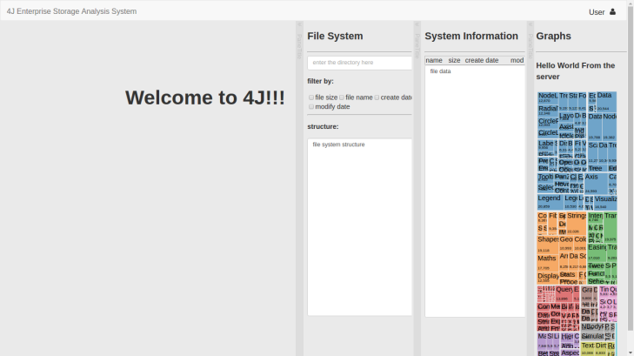
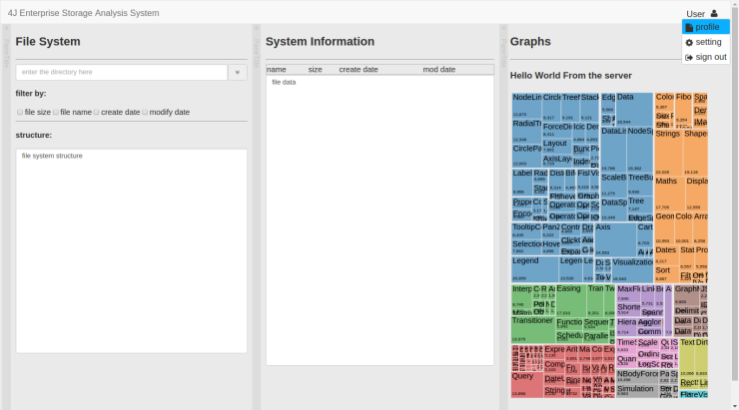
Front-end UI evolution
Version3: Three Slideable Panels and the Treemap
Pro: responsive & high efficiency
Con: the size of each panel was restricted, especially the treemap section

Slide 47
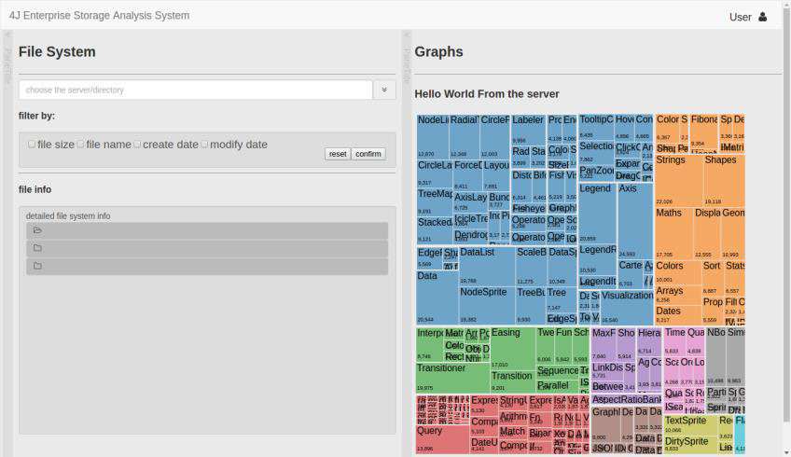
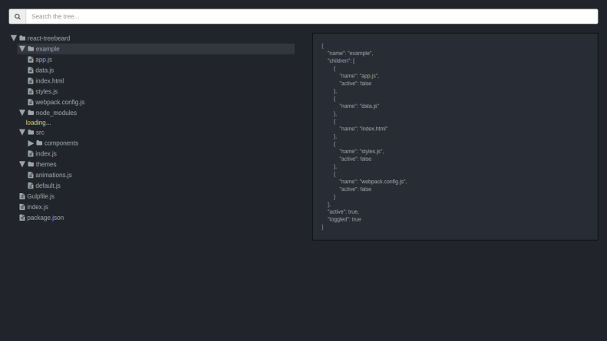
Front-end UI evolution
Version4: Two Slideable Panels
Achievement: responsive and function two sildeable panel front-end interface; functional file information browser and treemap
To do: intergrating the back-end data and the front-end UI

Slide 48
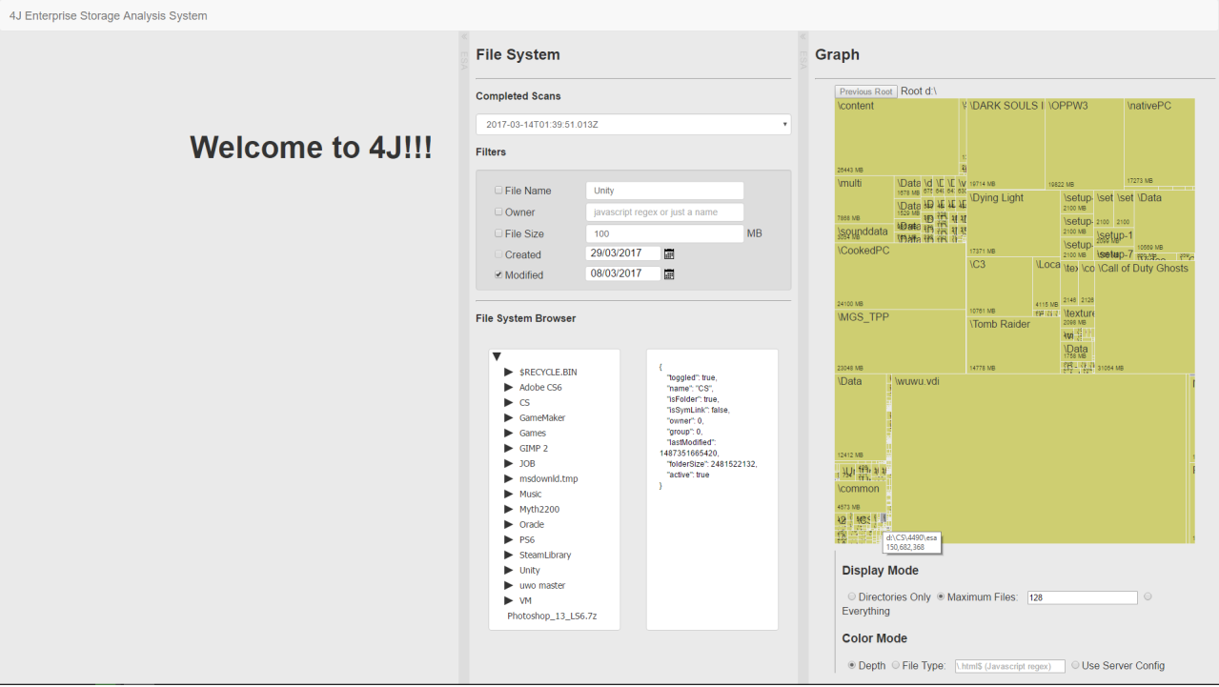
Final Design

Slide 49
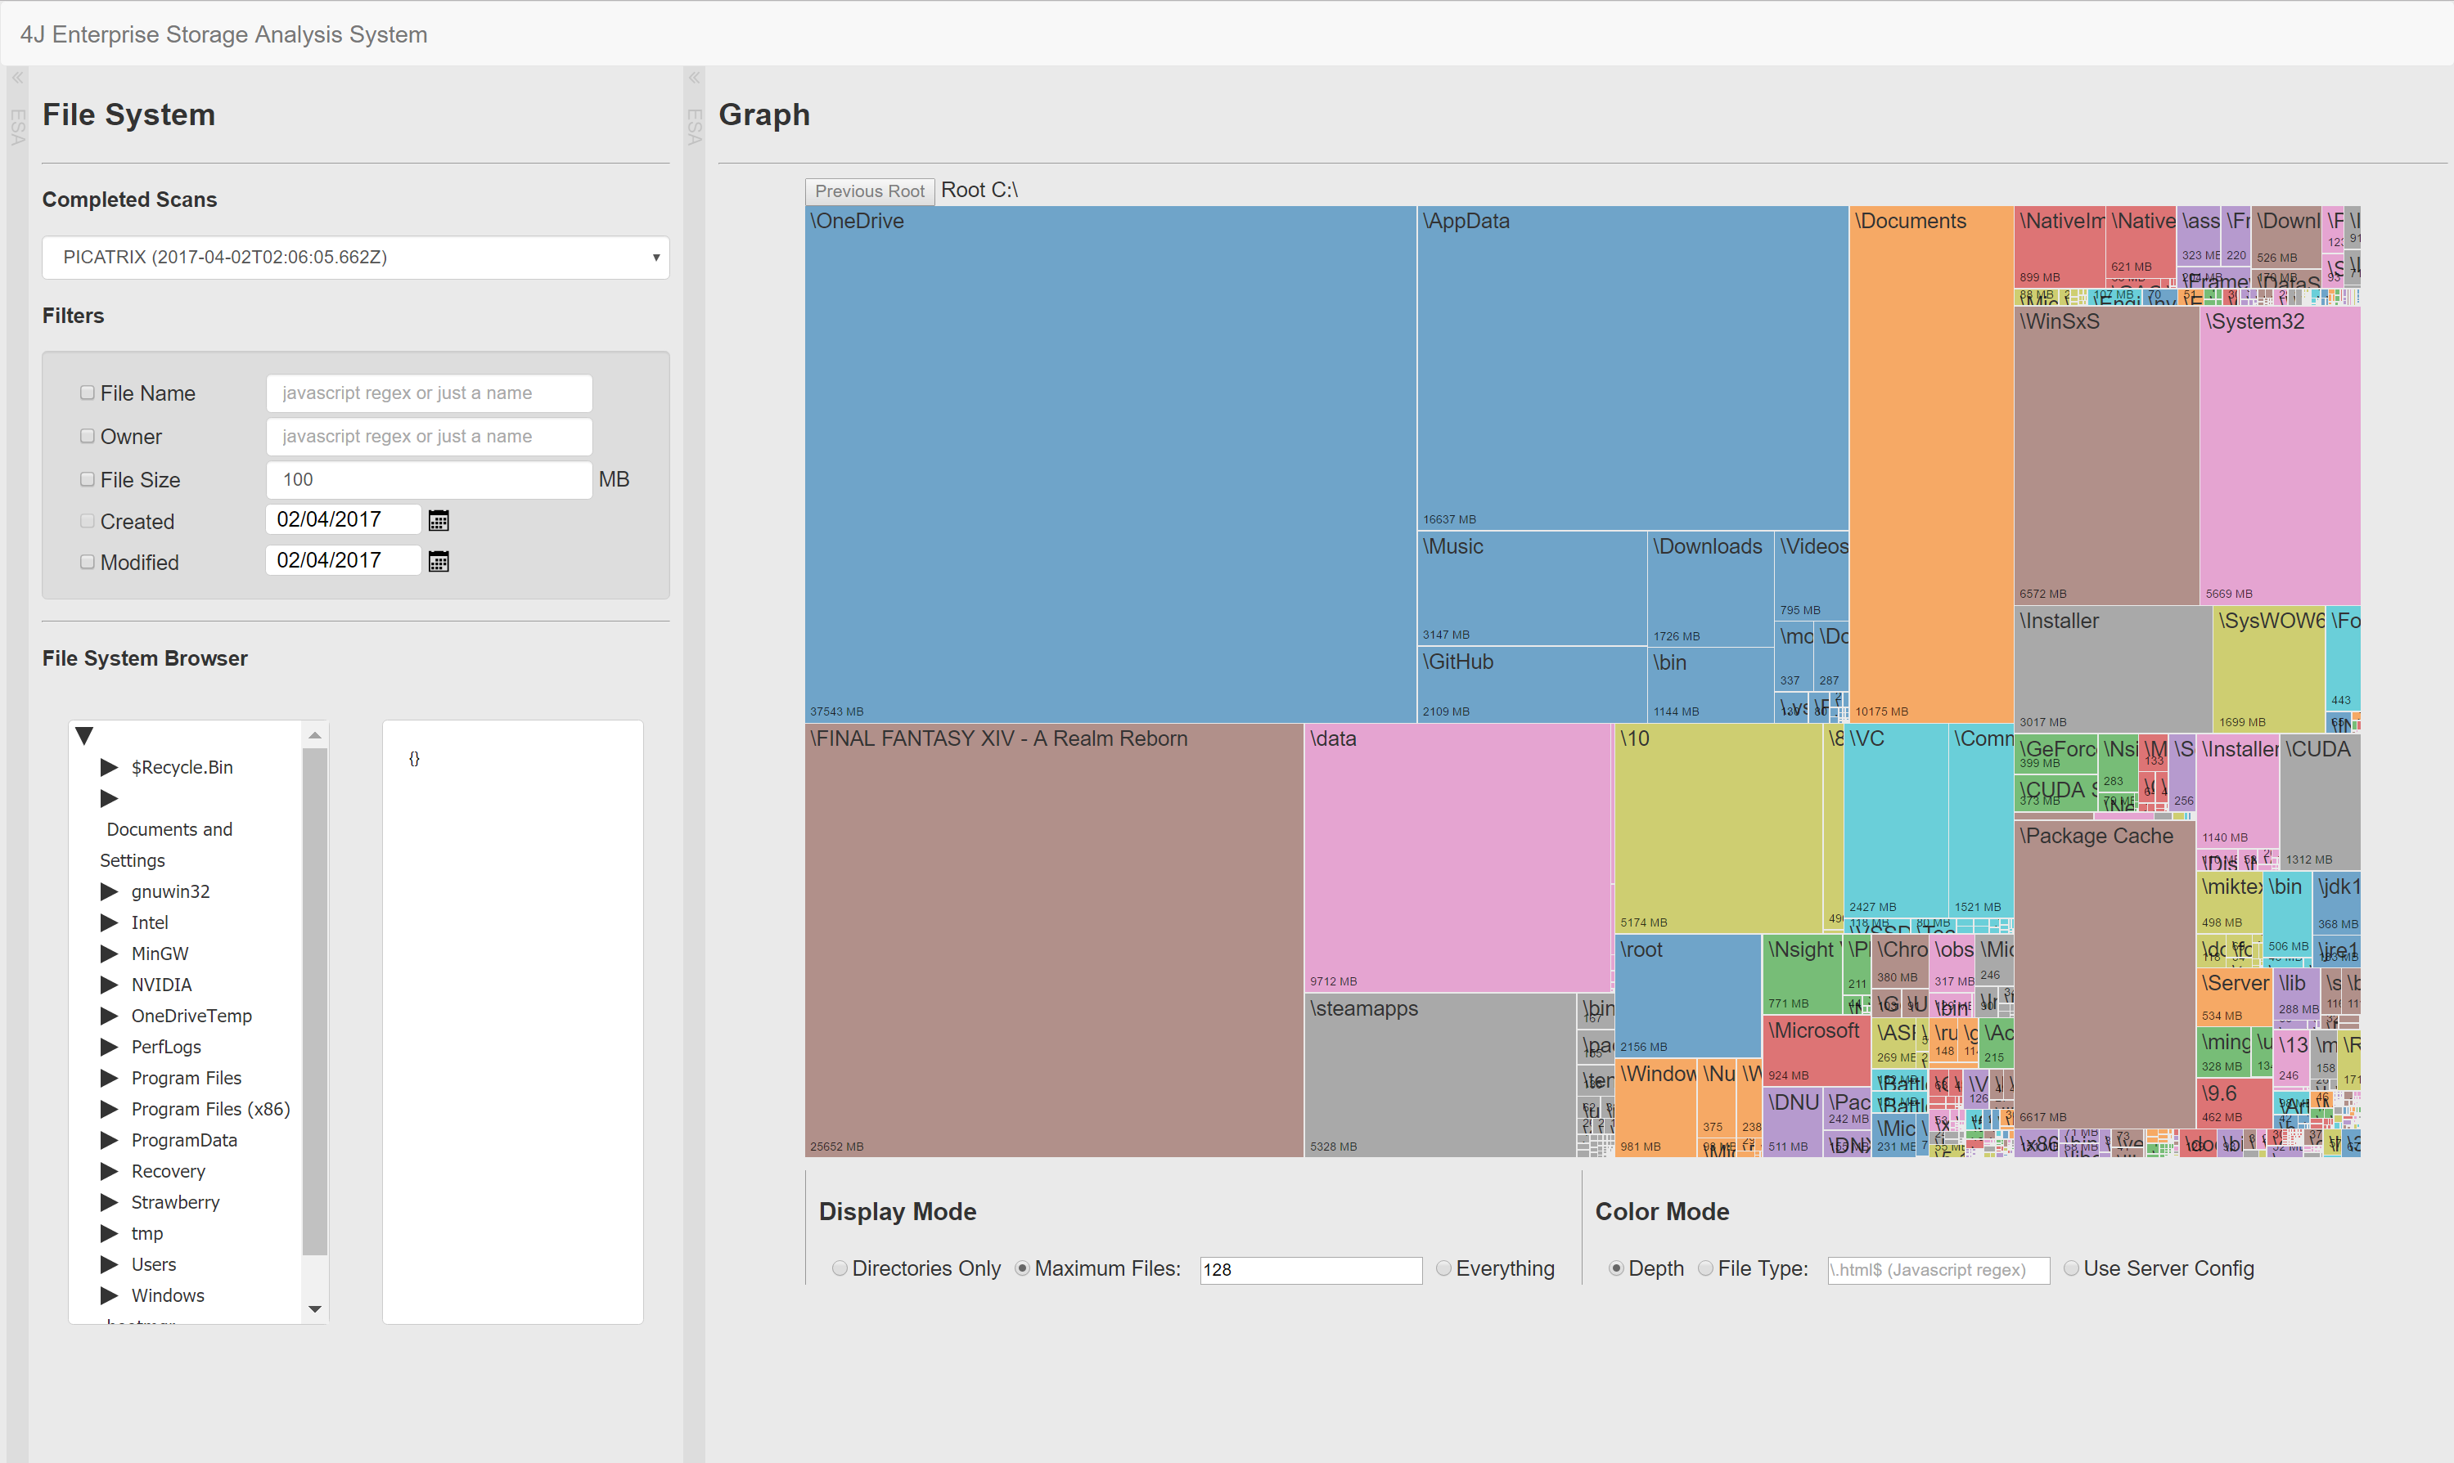
Final Design

Slide 50
Treemap
Enterprise Storage Analysis

Slide 51
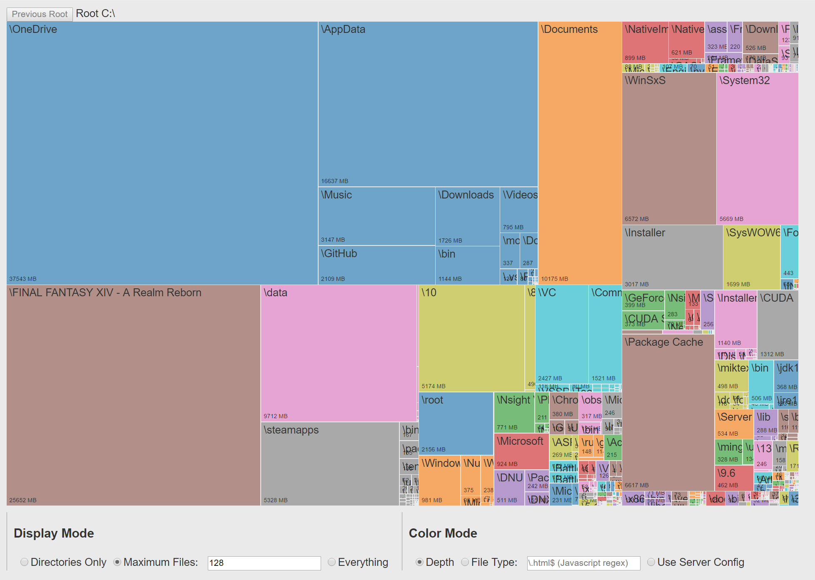
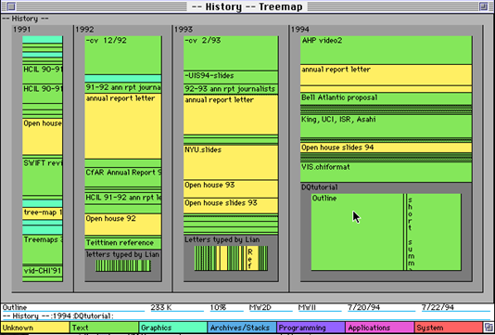
Treemap ESA
Treemaps are an intuitive way to analyze hierarchical data in a 2D graphical format
Developed by Ben Schneiderman in the 1990s for file system analysis
Primary visualization of programs such as WinDirStat and KDirStat

Slide 52
Treemap React Component
Extends work by Mike Bostock on rendering treemaps using the D3.js library
Converted code to work with our data format
Added new information to the output
Generalized the rendering code for ESA
Developed a React Component
Wraps several preconfigured D3 calls
Handles event chains
Contains color generator and filter highlighting Functions
Support for SVG or DIV output
Modern Browsers render HTML Div trees faster than SVG trees

Slide 53
Treemap Improved Render Times
SVG – Scalable Vector Graphics
Reduced performance with large data sets
Can be saved to a vector graphic image
HTML – Hyper Text Markup Language
Overall improved performance using HTML in the DOM
No way to save a vector graphic

Slide 54
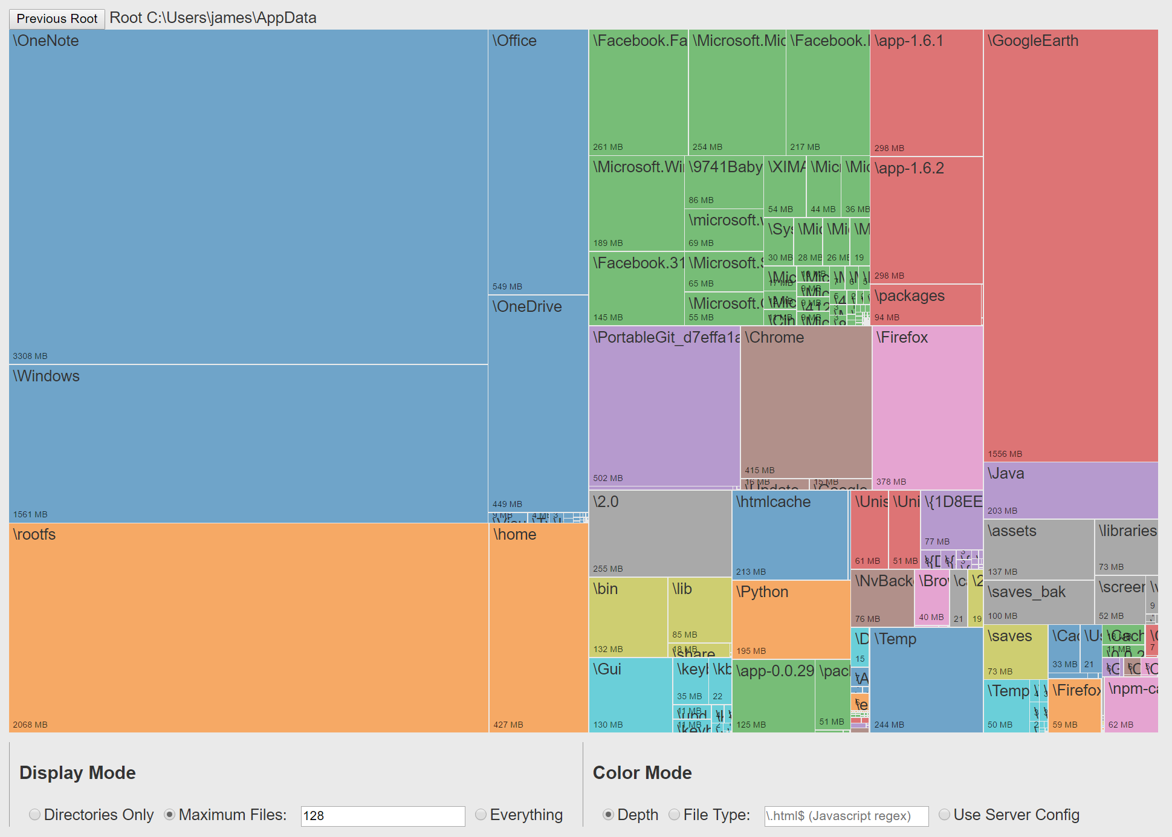
Treemap Drill Down
Drill

Slide 55
Filters
Enterprise Storage Analysis

Slide 56
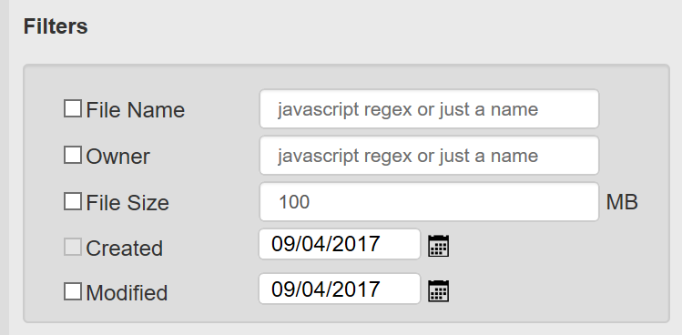
Filters
Filtering of the data is important for isolating files with specific criteria.
File Name
A regex of the filename may be used to highlight files of a specific type or with a specific pattern in their name
Size
Files over a certain size may be highlighted
Modified
Files modified before a certain date may be highlighted

Slide 57
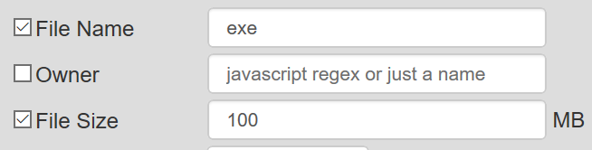
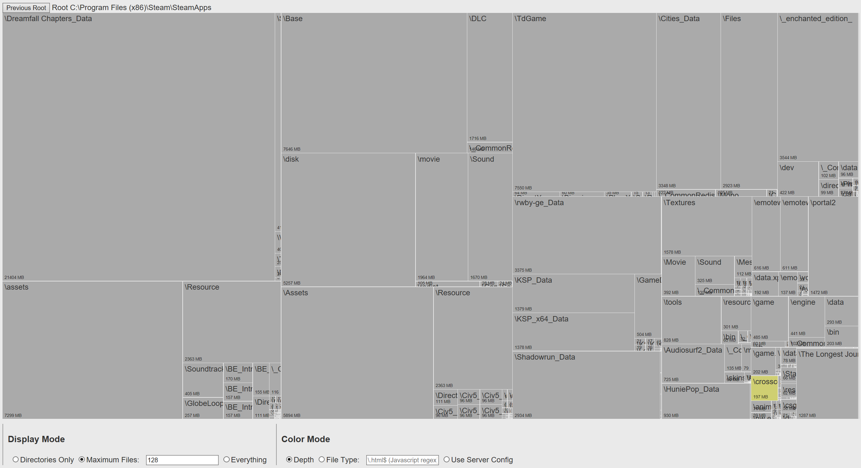
Filters

Slide 58
Demo
Enterprise Storage Analysis

